Slide 1
Unix basics – Lab. 2

Slide 2


Unix command structure
command will be : passed in the console (ex: pwd, ls, cd, mkdir..);
[options] are :
the options for command;
can be:
short option – single letter preceded by a single hyphen (-);
long option – word preceded by a double hyphen (--);
command + short/long option :
[values] are :
values for option;
might not exist;
the values from the command line are separated by spaces;
the interpreter (the shell) from the command line is case-sensitive;
command + value :

Slide 3
Commands
command only : pwd, ls, history
command + option : ls –l, ls –a, ls –all
command + value : mkdir dir_name, touch file_name
command + option + value : ls –l /etc, ls -l -s /etc, ls -ls /etc

Slide 4
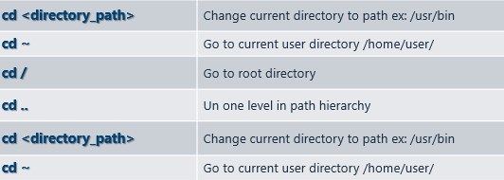
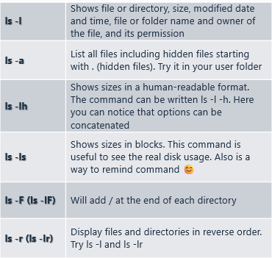
First commands
cd
change working directory
ls [options] [directory]
list the content of an directory
pwd
print work directory. Path where we are
help, history, clear, cut, file, grep, head, less, more, sort, tail, wc, who, whoami, users, uname
other commands

Slide 5
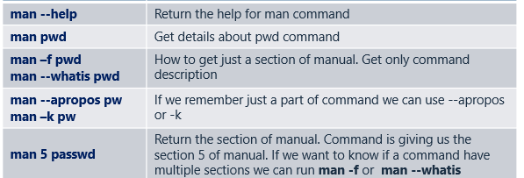
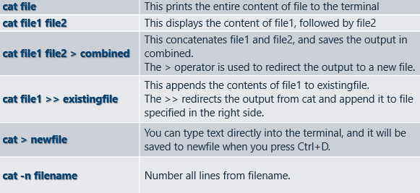
First commands
man
manual used to display the manual or documentation
concatenate used for displaying the contents of files, combining files, and creating new files.
cat [options] [file …]

Slide 6
5 min practice
Navigation commands
(pwd , ls, cd)
Read about commands:
by using man command and cmd_name –help;
2. Navigate to root folder cd ..
3. Type ls –ls
4. Try command cd ~ followed by pwd.
What did you see ?
5. Now try cd / followed by pwd
Not sure where you are ?
6. Try ls –ls
Now let’s try cd~; ls /bin; ls bin .
What you find and why ?
Notes:
cd .. moves one directory up.
ls -ls lists files with sizes.
cd ~ moves to the home directory,
and pwd confirms it.

Slide 7
man command
How can we find details about a command?
man command_name
Command_name refers to the specific command for which we are seeking information.
man
Manual Pages. The first command to remember
Contains info about almost everything: other commands, system calls, c/library functions, other utils, applications, config. files.
Notes:
Getting help for manual : man --help
Getting details about a command : man pwd
How to get just a section of manual. Get only command description : man – f pwd, man –whatis pwd
If we remember just some part of command but not entire name we can use : man –-apropos pw
man –k pw

Slide 8
5 min practice
UNIX Manual
See what is displaying on your machine: man --help
Search for commands that contains an keyword: man –-apropos …
Get short description for a command: man –-whatis …
Try something like: man –K ip –o pwd. Try to explain what this command do
Get details about history command from man and use it. What it’s doing
Notes:
man --help → Displays the help menu for the man command.man --apropos <keyword> → Searches for commands related to a specific keyword.man --whatis <command> → Gives a short description of a command.man -K <term> -o <file> → Searches for the specified term (ip in this case) in all man pages and saves the output to a file.man history → Opens the manual page for the history command.history | tail -10 → Displays the last 10 executed commands.

Slide 9
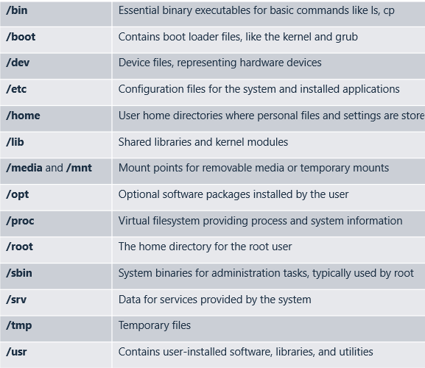

File system overview
sudo blkid
block identifier display info about block devices
lsblk -f
list block devices and option –f means and file systems
cat /etc/os-release
Get OS info
lsb_release -a
hostnamectl
uname
File system types:
ext2, ext3, ext4, XFS, btrfs, ZFS, ReiserFS, F2FS, vfat, NTFS

Slide 10

Managing files and directories
touch <file_name>
Create an empty file or update the timestamp of an existing file.
cat <file_name>
Displays the content of a file in paginated format, allowing easy navigation
head –n x <file_name>
Displays the first or last lines of a file
tail –n x <file_name>
rm <file_name>
rm –r <dir_name>
Recursively delete all files and directories from a directory.
Delete a file
mv <source> <destination>
Move file directory from a location to another
cp <source> <destination>
Copy a file from source to destination
mkdir <dir_name>
Create a directory
nano <file_name>
Edit a file. Ctrl+X exit, Ctrl+O save
vi vim
Basic editors. Insert … edit content … ESC … :q (quit without save) :x (save and exit)

Slide 11
UNIX keyboard shortcuts
CMD | Description
TAB | Autocompletion of the command line (ex. long file name, type start of it then tab).
Arrows up and down | navigate through commands history typed by you
Ctrl-C | Stop the execution of the current program
Ctrl-Z | Suspend the execution of the current program (remains on in background)
Ctrl-D | Close the working session (sometimes equivalent with EOF)
Ctrl-S | Lock the console (never saves a file) you can’t type anything anymore for putty.
Ctrl-Q | Unlock the console after using Ctrl+S by reflex to try to save a file
Ctrl-K | Cut/copy text from current position to end of line
Ctrl-Y | Paste copied text with Ctrl-K (you can also use mouse select and then right mouse click to paste – it will paste the selected)
Ctrl-R | Search commands history
Ctrl-A | Move cursor at the beginning of cmd line
Ctrl-B | Move cursor back one char
Ctrl-F | Move cursor forward one char
Ctrl-E | Move cursor at the end of the cmd line

Slide 12
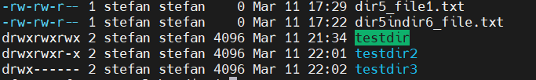
Files and directories permissions
drwxrwxrwx
Specify if it’s a file ( - ) or directory ( d )
Set permissions for owner u
Set permissions for users group g
Set permissions for others o
000 → 0 no rights
011 → -wx =000+ 010+001 = 0+2+1 =3
001 → 1 execution rights
111 → rwx = 100+010+001 = 4+2+1 =7
010 → 2 write rights
101 → r-x = 100+000+001 = 4+0+1 =5
100 → 4 read rights
110 → rw- = 100+010+000 = 4+2+0 =6

Slide 13
Files and directories permissions
chmod
r (read) - right for reading the file/dir contents
Permissions can be set in 2 ways:
symbolic change:
chmod [group][operator] [description] [file|directory]
chmod u=rx,g+x,o-r myfile explicit rx for owner, add x to group, remove r for others
numeric numeric:
chmod [number_description] [file|directory]
chmod 731 myfile means rwx-wx—x full owner, rx group, x others
w (write) - to write/modify in the file or dir content (create/delete files in directory)
x (execute) - right to execute the file or have dir access

Slide 14




Data streams
stdin , stdout , stderr
Unix command
1
0
2
stdin
stdout
stderr
Notes:
stdin (standard input - 0): The default way a program receives input, typically from the keyboard.stdout (standard output - 1): Where the program sends its normal output, usually displayed on the terminal.stderr (standard error - 2): Used for error messages or diagnostic information, also usually displayed on the terminal but can be redirected separately from stdout.
The house is the Unix command.stdin (backpack pig) enters the house → This is input given to the command.stdout (happy pig) exits the house → This is the normal result of running the command.stderr (serious pig) exits the house too → This is an error message if something goes wrong.

Slide 15

I/O data streams
Standard input (stdin) → 0 → keyboard
Standard output (stdout) → 1 → screen
Standard error (stderr) → 2 → screen
File redirection:
< input
> output
>> output append
command < file
command > file
command >> file
$date
it prints the current date and time
$date > file
redirect standard output to a file
$sort <file1> file2
invokes the sort program with input taken from file1 and output sent to file2
$cat file1 file2 file3 | sort>/dev/lp
the pipe helps connect a particular program’s output as input to other programs
Notes:
Standard input: uses file descriptor 0. by default assigned to the user’s terminal keyboard. Can also be obtained from standard output of another program (redirection). Standard output: uses file descriptor 1. by default assigned to the user’s display terminal. Can also be used as input to another program (redirection).
Standard error: uses file descriptor 2. by default file is assigned to the user’s display terminal. Standard error output can’t be used as input to another program but error output can be redirected to a file (redirection).
Folosirea caracterului > la sfarsitul comenzii, urmat de numele unui fisier text. Redireactioneaza iesirea standard spre fisierul specificat. Daca fisierul exista, este suprascris, daca nu este creat.
Folosirea caracterului >> se face adaugare de fisier
STDERR – makes sense only for commands that send something to STDERR
$cat file1 file2 file3 | sort>/dev/lp - This invokes the cat program to concatenate three files and send the output to sort to arrange all the lines alphabetically. The output of sort is redirected to the file /dev/lp, a familiar name for the special character file for the printer.

Slide 16
Commands for navigating through the file system
tree
Display the directory structure
pwd
print work directory. Path where we are
ls
df
Displays available disk space
List directory contents
chown
Change file ownership
cd
Change current directory
chmod
Change file permissions
du
Shows disk usage
find
Looks up a file in a directory tree
Notes:
Ls *.lst – lists all files with extension .lst

Slide 17
Commands for working with files
cat
Display and concatenate files
more/less
Pagers to display contents of large files
touch
By touching a file you either create it (if it doesn’t exists), or you update it
cp
Copies files / directories
which
Show full path of cmds
mv
Moves or renames files/directories
grep
Searches its input for a pattern
Removes file(s) and/or directories
head
Display top of a file
rm
tail
Display end of a file
Notes:
rm ??* - removes all files with at least 2 characters
cp *.[ch] cprogs – copies all files with .c or .h extension into cprogs
rm *[!a-zA-Z]* - displays files note00, …. note19
“$SHELL” DIFERIT de ‘SHELL’

Slide 18
Commands for working with directories and files
UNIX Commands
mkdir dir_name
Create a directory named dir_name
rmdir dir_name
Remove directory named dir_name
cp src_dir dst_dir
Copy the src_dir into dst_dir
cp src_f dest_f
Create a copy of src_f named dest_f
mv src_dir dst_dir
Move/rename directory src_dir into dst_dir
mv src_dir dst_dir
Move/rename directory src_dir into dst_dir

Slide 19
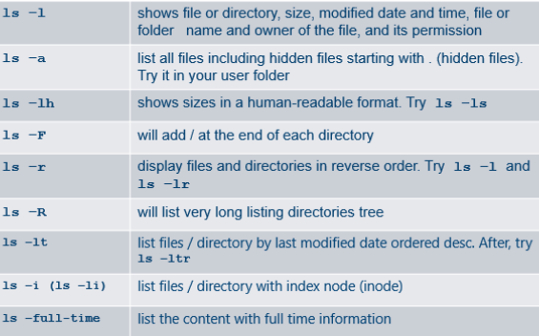
5 min practice
Navigation commands
Try different ls:
ls | less ls with pipe operator means redirecting of output to another command. List the content of directories : /bin /usr /etc usr/include by using less

Slide 20
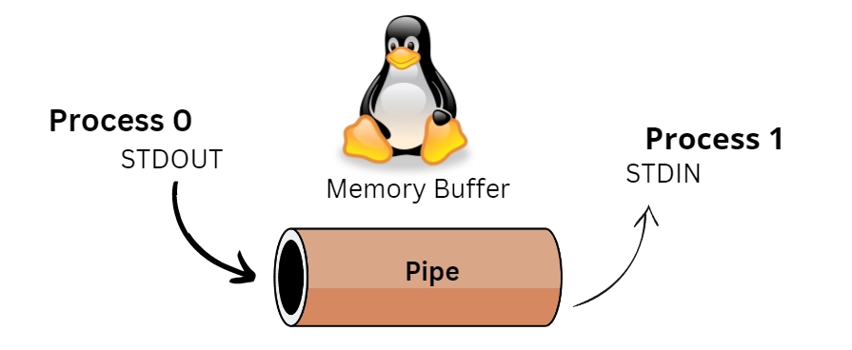
What’s a pipe?
Pipes
Is a method of interprocess communication (IPC);
In a shells a “|” symbol used;
It means that the output of one command (stdout) serves as an input for another command (stdin);
A set of “piped” commands is often called a pipeline;
$cat file1 file2 file3 | sort>/dev/lp
Notes:
Process 0 (STDOUT): A command generating output.
Memory Buffer: The pipe temporarily stores data between the two processes.
Process 1 (STDIN): Another command consuming the output as input.
Pipes work between processes in user space, and the kernel handles the
memory buffer.
PIPES:
A pipe is a holder for a stream of data
A pipe can be used to hold the output of one program and feed it to the input of another
No temporary file is create. Used to solve many text manipulation problems!

Slide 21
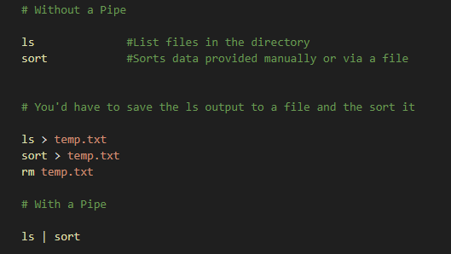
Pipes - Why use them?
Because by combining simple OS utilities one can easily solve more complex task;

Slide 22
Connecting commands with PIPES
To see who is on the system with you type:
who
One method to get a sorted list of names is to type:
who > name.txt
sort > names.txt
This is a bit slow and you have to remember to remove the temporary file called names when you have finished. What you really want to do is connect the output of the who command directly to the input of the sort command.
This is exactly what pipes do. The symbol for pipe is the vertical bar |
This example gives the same result as above, but quicker and cleaner;
who | sort
Pipe the output of command1 to the input of command2:
command1 | command1

Slide 23
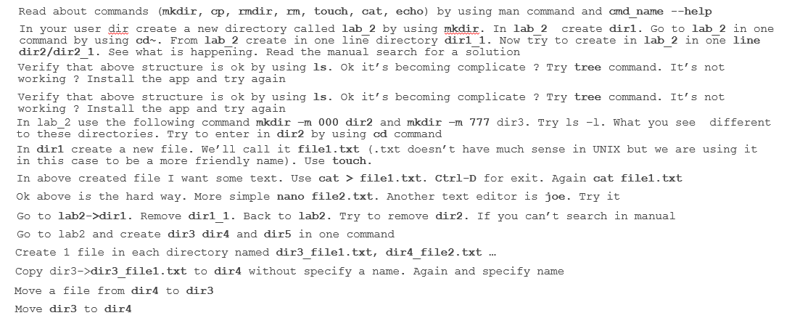
15 min practice
Usual Unix commands
Notes:
The file system:
Navigate with cd, pwd, ls
Organized by directories mkdir, rmdir, and cp, mv rm for file.
If you run the cd / command, you'll navigate to the root directory of your Linux environment, which contains directories like mnt, home, var, tmp, etc.
chmod +x unix_commands_practice.sh ./unix_commands_practice.sh

